Slide 1


RAMAIAH INSTITUTE OF TECHNOLOGY, Bangalore (Autonomous INSTITUTE Affiliated To VTU) Dept. of Electronics and Communication Engineering
Identification of Tomato Plant Diseases by Leaf Image Using SqueezeNet Model
Under the Guidance of :
H. Mallika , Assistant Professor

Slide 2




Anuj Pratap Singh
Beboto Ghosh
Shourya
Group Members:
1MS21EC023
1MS21EC035
Tathagata Ghosh
1MS21EC101
1MS21EC123

Slide 3
—William Ruckelshaus.
“Nature provides a free lunch, but only if we control our appetites.”

Slide 4
01
Introduction
02
Problem Statement
03
TABLE OF CONTENTS
Objective and Scope
04
Literature Survey
05
Proposed Design and Methodology
08
Timeline & References
Brief Introduction to review 1
Problem statement of our topic
Objectives and future Scopes
Brief Description of two research papers
Methodology used for our dataset training and testing purpose
06
Results and Discussion
07
Results obtained Training and Testing the model
Conclusion and Future Work
Conclusion of the project
Timeline for the project and References taken from different research papers

Slide 5
Introduction:
Various methods, including the CNN (Convolutional Neural Network) approach within deep learning, are employed to address plant pests and diseases. CNN utilizes architectures like AlexNet, MobileNet, and VGG, primarily emphasizing accuracy.
Here in this review We will be using these following Deep Learning models -
The SqueezeNet architecture employs three key strategies to achieve high accuracy while minimizing parameters. Its compact size requires less bandwidth for model deployment on cloud platforms and facilitates easier deployment on memory-limited hardware devices like FPGA.
MobileNet is a highly efficient convolutional neural network (CNN) architecture designed for mobile and embedded devices. Developed by Google, it strikes a balance between accuracy and computational efficiency, making it ideal for applications with limited computational resources

Slide 6
Problem statement: Identification of Tomato plant diseases by leaf images using SqueezeNet and MobileNet model.
Early and accurate detection of plant diseases is crucial for reducing yield and quality losses in agriculture.​
This study focuses on tomato plant disease, showcasing the potential of CNN methods, specifically with SqueezeNet architecture, for disease detection in agriculture.​
Squeezenet architecture enables the creation of compact models suitable for implementation on smartphones, servers, and microcontroller devices.​
This research aims to build a model using SqueezeNet architecture to classify various types of tomato plant diseases, including healthy leaves, utilizing the "Tomato-Village dataset".

Slide 7
Objectives and Scope.
Scope
The project aims to develop an automated tomato leaf disease detection system using the SqueezeNet deep learning model, focusing on identifying early blight, late blight, and bacterial spot.
Understanding & implementing SqueezeNet, emphasizing size reduction while preserving accuracy
Collecting and preprocessing tomato leaf images, including healthy and diseased samples.
Training SqueezeNet, fine-tuning hyperparameters, and optimizing for accurate disease detection.
Emphasizing model size reduction and computational efficiency for practical deployment.
Objective Clarity
Leveraging deep learning techniques, the system targets accurate disease classification, facilitating efficient disease management for farmers.
Deep Learning Utilization
By offering timely interventions based on automated disease detection, the project seeks to reduce crop losses and enhance agricultural productivity.
Timely Interventions
Real-Time Processing
Implementation includes developing a system capable of processing leaf images in real-time, ensuring swift responses to disease outbreaks.
Consideration is given to deploying the system in resource-constrained environments, such as edge computing devices and IoT platforms, to enhance accessibility for farmers.
Deployment Flexibility

Slide 8
Content Table
Title | Author(s) | Published
Identification of Tomato Plant Diseases by Leaf Image Using Squeezenet Model | Akbar Hidayatuloh, M. Nursalman, Eki Nugraha | ICITSI, Bandung, Indonesia (2018)
Tomato Leaf Disease Detection using Deep Learning | H. Mallika, B. Jagadeeswar Reddy, Adavi Ananth, Bhimaraju Sai Charan, Gattu Sreedhar Nikhil | ICA5NT 2023
Plant Disease Identification Using a Novel Convolutional Neural Network | SK Mahmudul Hassan and Arnab Kumar Maji | IEEE Access (2022)
Diagnosis of Tomato Plant Diseases Using Pre-trained Architectures and A Proposed Convolutional Neural Network Model | Dilara GERDAN KOC , Caner KOC , Mustafa VATANDAS | International Journal on Recent and Innovation Trends in Computing and Communication, Mar 2023
A Review on Tomato Leaf Disease Detection using Deep Learning Approaches. | Cheemaladinne Vengaiah, Srinivasa Reddy Konda. | Journal of Agricultural Sciences, March 2023

Slide 9
Author: Akbar Hidayatuloh, M. Nursalman, Eki Nugraha
Title: Identification of Tomato Plant Diseases by Leaf Image Using Squeezenet Model
Published: International Conference on Information Technology Systems and Innovation (ICITSI), Bandung, Indonesia (2018)
Brief description:
CNN methods are effective in addressing plant pest and disease issues. popular architectures like AlexNet,VGG prioritize accuracy over model size. Yet, compact models are crucial for deploying on resource-constrained servers or embedded systems.
Squeezenet architecture offers high accuracy with minimal parameters through three key strategies. Its small size requires less bandwidth for cloud model export and facilitates deployment on memory-constrained FPGA and other hardware devices.
Squeezenet architecture is designed to be efficient. It employs three strategies to reduce model size: smaller filter sizes, fewer input channels, and downsampling at the network's end.
It was concluded that the CNN model with Squeezenet architecture effectively identifies six types of tomato plant diseases and healthy leaves with an average accuracy of 86.92% . Its compact design makes it suitable for implementation on mobile devices.

Slide 10
Author: H. Mallika, B. Jagadeeswar Reddy, Adavi Ananth, Bhimaraju Sai Charan, Gattu Sreedhar Nikhil
Title:Tomato Leaf Disease Detection using Deep Learning
Published: ICA5NT 2023
Brief description:
Deep Learning (DL), a subset of Artificial Intelligence (AI), holds significant promise in detecting and classifying plant diseases, leveraging machine learning models for image processing.
The Tomato Leaf Disease Study Dataset, containing approximately 16,000 images of plant leaves, including healthy and diseased samples covering 9 diseases, facilitates the development of accurate image classifiers for analyzing plant diseases.
Identification and classification of diseases on tomato leaves are conducted using MobileNet and AlexNet models in this study.
Results indicate that MobileNet achieves the highest accuracy with a learning rate of 0.00001 using the Adam optimizer, while AlexNet achieves its maximum accuracy with the same learning rate and optimizer.

Slide 11
Author: SK Mahmudul Hassan and Arnab Kumar Maji
Title: Plant Disease Identification Using a Novel Convolutional Neural Network
Published: IEEE Access (2022)
Brief description:
Deep learning, particularly CNN, has gained attention for its potential in agricultural applications, including disease identification, due to its ability to automatically extract relevant features from datasets.
In response, this paper proposes a novel lightweight CNN architecture based on Inception and ResNet, featuring fewer parameters for disease identification in plants.
The proposed CNN model, incorporating Inception and residual connections, demonstrates high effectiveness in disease classification.
Future research will explore the model's performance in additional agricultural fields such as weed detection and pest identification.

Slide 12
Author: Dilara GERDAN KOC , Caner KOC , Mustafa VATANDAS
Title: Diagnosis of Tomato Plant Diseases Using Pre-trained Architectures and A Proposed Convolutional Neural Network Model
Published: International Journal on Recent and Innovation Trends in Computing and Communication, Mar 2023
Brief description:
The primary goal of the study is to enhance the speed and accuracy of diagnosing tomato plant diseases by leveraging deep learning techniques, specifically convolutional neural networks (CNNs).
The study analyzes a range of diseases commonly affecting tomato plants, including bacterial spot, early blight, leaf mold, septoria leaf spot, target spot, mosaic virus, and yellow leaf curl virus. This comprehensive approach ensures effective detection and management of various potential threats to tomato crops.
The study explores different CNN architectures, including a custom-built CNN model with three 2D convolutional layers followed by a flatten layer, as well as pre-trained Keras models such as DenseNet201, InceptionResNetV2, MobileNet, and Visual Geometry Group 16. By examining multiple architectures, the study aims to identify the most efficient and accurate model for disease diagnosis.
The proposed CNN model demonstrates significant efficiency, offering rapid diagnosis within approximately 14.9 minutes. This efficiency is crucial for agricultural applications, enabling timely responses to disease outbreaks and minimizing potential crop damage.

Slide 13
Author: Cheemaladinne Vengaiah, Srinivasa Reddy Konda.
Title: A Review on Tomato Leaf Disease Detection using Deep Learning Approaches.
Published: Journal of Agricultural Sciences, March 2023
Brief description:
The review thoroughly examines various CNN architectures, including DenseNet, ResNet, VGG Net, GoogleNet, AlexNet, and LeNet, showcasing their potential in detecting diseases in tomato leaves.
It utilizes the Plant Village dataset, encompassing distinct classes of tomato plant diseases along with healthy samples, ensuring comprehensive training and evaluation of the CNN models.
The review rigorously evaluates the performance of different architectural designs using the Plant Village dataset, offering insights into the efficacy of each model in accurately identifying the diverse range of tomato leaf diseases.
By addressing existing research gaps, the review contributes to the development of tools for supporting tomato leaf disease diagnosis and management, thereby aiding farmers in enhancing crop health and productivity.

Slide 14
Proposed Design and Algorithm
Classes | Number of Training Samples | Number of Testing Samples
Tomato healthy | 1926 | 481
Tomato Mosaic virus | 1790 | 448
Tomato yellow leaf curl virus | 1961 | 490
Target spot | 1827 | 457
Spider mites two spotted spider | 1741 | 435
Septoria leaf spot | 1745 | 436
Leaf mold | 1882 | 470
Late blight | 1851 | 463
Early blight | 1920 | 480
Bacterial spot | 1702 | 425
Total No. of Samples | 18345 | 4585
 | 22930
The proposed design aims to develop an efficient and accurate model for detecting various tomato plant diseases using the Squeezenet architecture. The model is designed to be compact and suitable for deployment on devices with limited computational resources, such as smartphones and microcontrollers.
1. Data Collection Source: The images of tomato leaves are obtained from the "Tomato-Village dataset."
2. Data Preprocessing:
Scaling:
All images are resized to a standard size of 224 x 224 pixels.
This uniformity in image size is essential for feeding the data into the Squeezenet model.
Normalization:
Pixel values of the images are scaled from the original range of [0, 255] to a range of [0, 1].
This normalization helps in faster convergence during the training process and improves model performance.

Slide 15
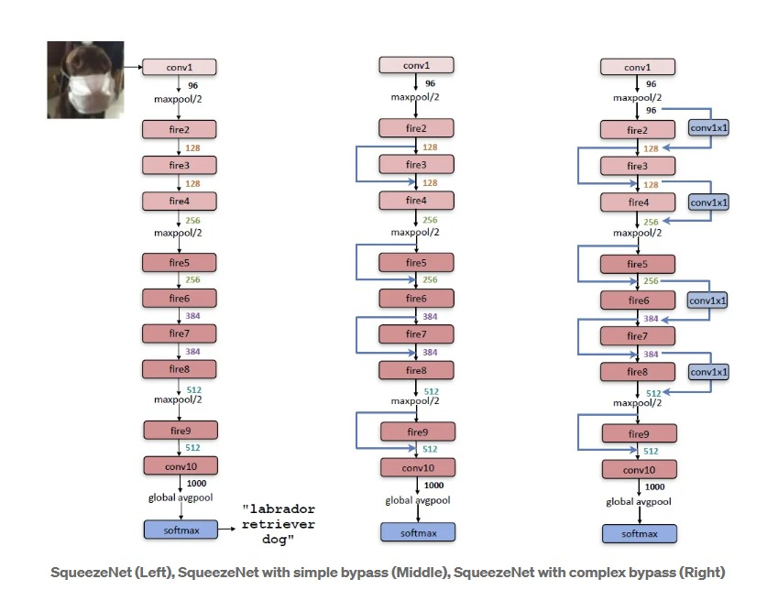
3. Squeezenet Model Architechture :
The Squeezenet model architecture is designed for efficient image classification with a smaller model size. It features:
Fire Modules: Each consists of a squeeze layer (1x1 convolutions) followed by expand layers (1x1 and 3x3 convolutions).
2. Parameter Efficiency: Uses 1x1 convolutions to reduce the number of parameters while maintaining performance.
3. Compact Size: Achieves similar accuracy to larger models but with significantly fewer parameters, making it suitable for devices with limited resources.

Slide 16
Methodology :
The identification process of tomato plants began with the process of collecting tomato leaf datas obtained from the "Tomato-Village dataset". Then the entire dataset will go through preprocessing consisting of scaling and normalization. In the preprocessing stage, a scaling process is performed to change the image size to 224 x 224 and the normalization process, which is the process of changing the image value whose origin has a value between [0,255] to a value of 0 to 1. By using the CNN method which is Squeezenet architecture, then the training dataset process is carried out to produce the model.
Start
Image Dataset
Scaling
Normalization
Testing Data
Training Data
Disease Classification
Trained Model
Trained with Squeezenet
Performance Evaluation

Slide 17
Tools
Python: Python serves as a primary programming language due to its extensive libraries for deep learning, such as TensorFlow, PyTorch, and Keras.
Deep Learning Frameworks: Frameworks like TensorFlow or PyTorch provide essential tools for building and training neural networks, including Squeezenet architecture.
Data Visualization Tools: Tools like Matplotlib can aid in visualizing data distributions, model performance, and training progress.
Convolutional Neural Networks (CNNs): CNNs are deep learning models particularly effective for image classification tasks.
Squeezenet Architecture: It is a CNN architecture designed to achieve high accuracy while minimizing model size and computational cost.

Slide 18
Results and Discussion

Slide 19
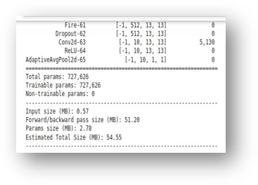
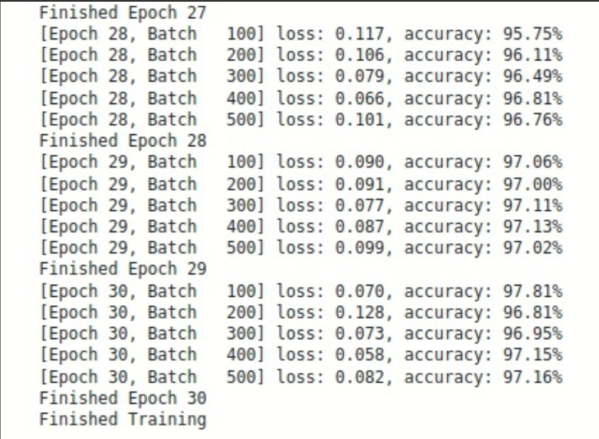
SqueezeNet Model
Training Result
The model is trained on a comprehensive dataset of tomato leaf images, encompassing healthy leaves and various disease-affected leaves. Reduction in number of trainable parameters with SqueezeNet. Evaluating all the parameters to record performance of the model.
Training Result for SqueezeNet model Model Summary

Slide 20
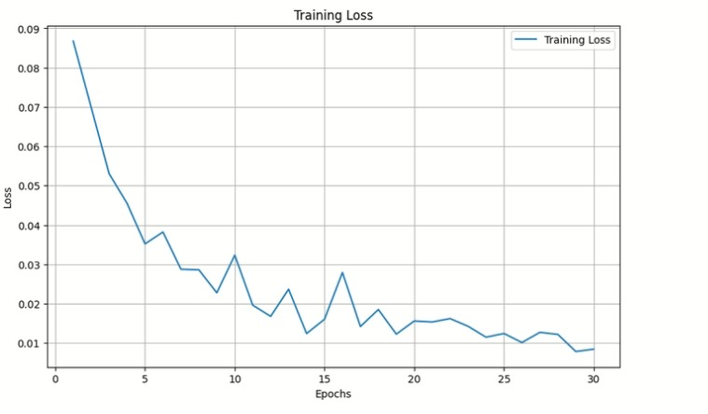
Training Loss graph for SqueezeNet model

Slide 21
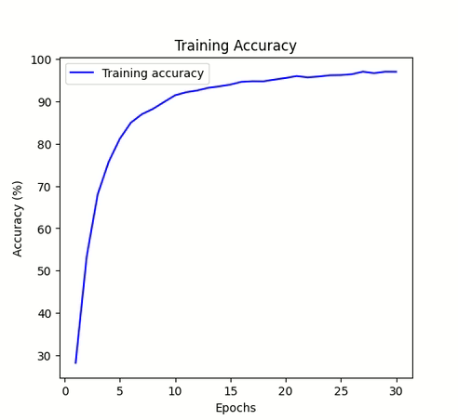
Training accuracy graph for Sueezenet model

Slide 22
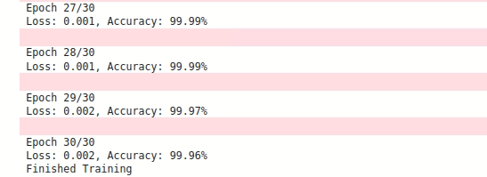
MobileNet Model
Training summary of MobileNet model
It displays a training log for a machine learning model, focusing on Epoch 30, the completion of the training process. Total Training Time 10123.65 seconds. The model achieves very high accuracy (99.96% to 99.97%) during Epoch 30. The loss remains very low (0.001 to 0.002), indicating good model performance. Training Duration The total training time for the model is approximately 10123.65 seconds.

Slide 23
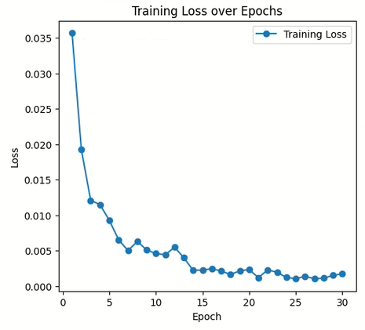
Training Loss graph for MobileNet model

Slide 24
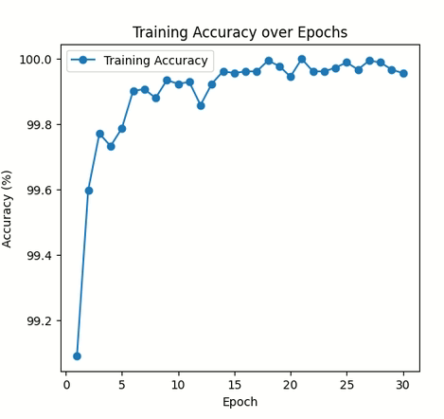
Training accuracy graph for Mobilenet model

Slide 25
Comparison table of Squeezenet and MobileNet model
Parameters | SqueezeNet | MobileNet
Total Epochs | 30 | 30
Accuracy | 97.16 % | 99.96%
Loss | 0.082 | 0.002
Number of Trainable Parameters | 727,626 | 2,249,492
Training Time | 5717.2186 sec. | 10123.65 sec.

Slide 26
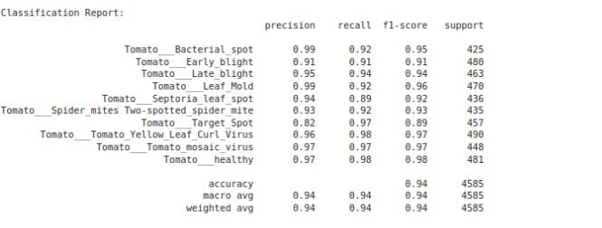
Testing Results
SqueezeNet Model
Performance of SqueezeNet Model under testing

Slide 27
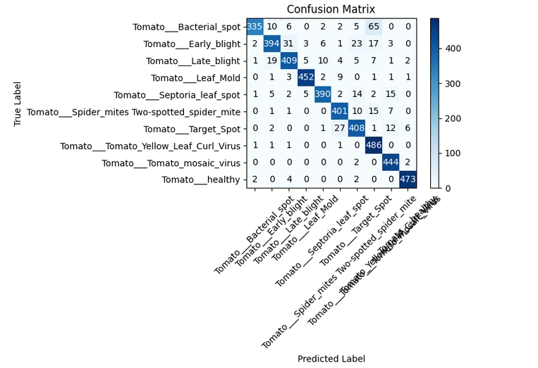
Confusion Matrix for Squeeze Net model

Slide 28
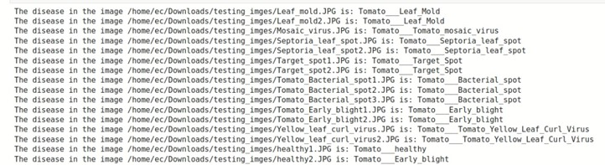
Samples of Predicted images from Squeeze Net Model
Fig.includes a screenshot displaying a set of random image samples along with their respective classification results generated by the SqueezeNet model. This demonstrates the model’s ability to accurately identify and classify various objects within the images, highlighting its efficiency and accuracy in real-world scenarios.

Slide 29
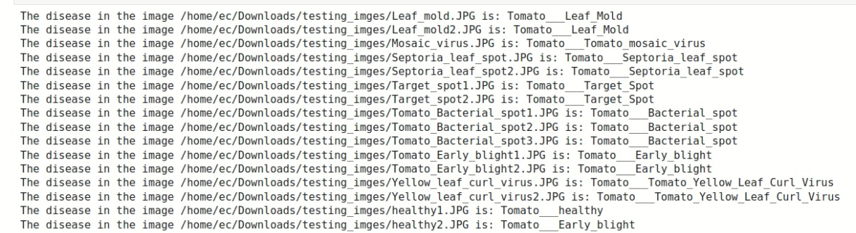
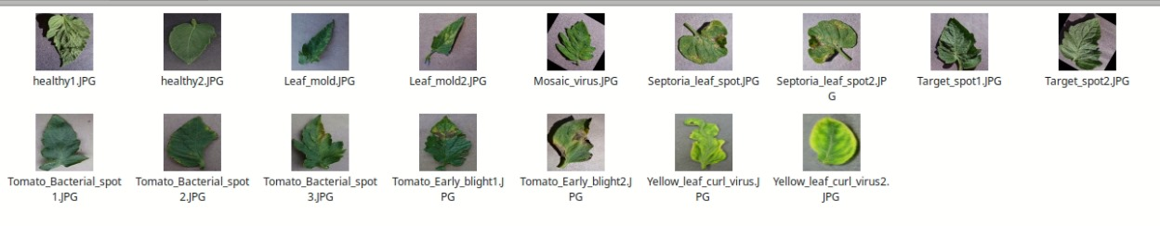
Predicting Tomato Plant Diseases Using a Pre-Trained Model

Slide 30
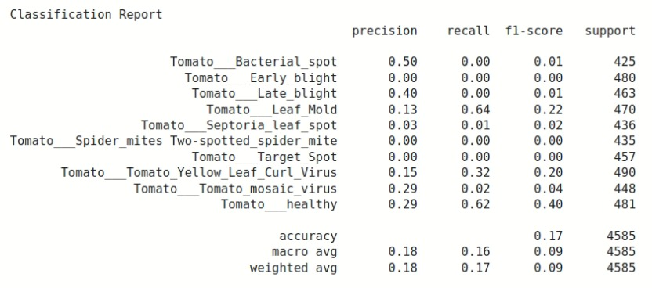
MobileNet Model
Classification Report for MobilNet Model

Slide 31
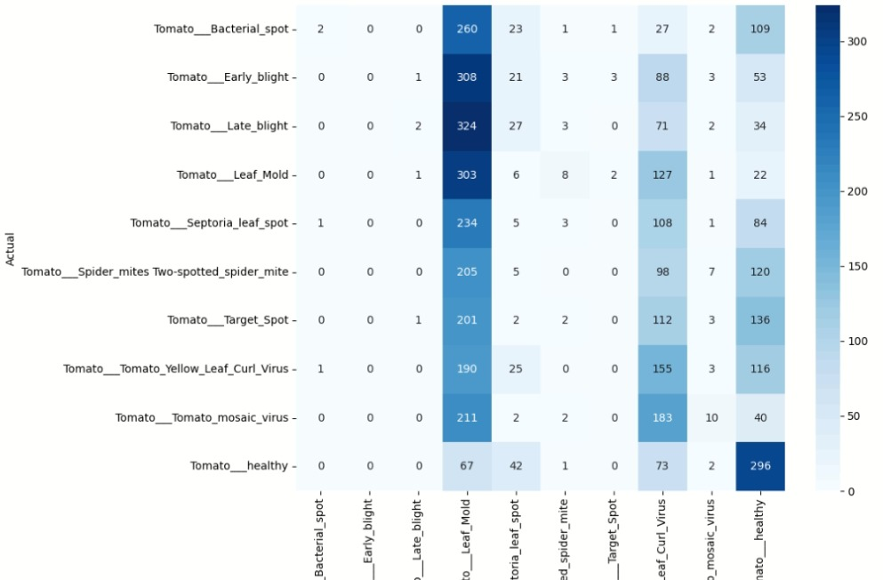
Confusion Matrix for MobileNet Model

Slide 32
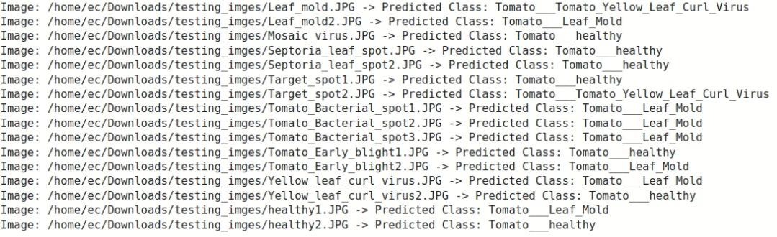
Prediction Results of Mobile Net Model
Fig.includes a screenshot displaying a set of random image samples along with their respective classification results generated by the Mobile Net model. This demonstrates the model’s ability to accurately identify and classify various objects within the images, highlighting its efficiency and accuracy in real-world scenarios.

Slide 33
Comparison table of Squeezenet and Mobilenet Model
 | SqueezeNet Model |  |  |  | MobileNet Model
Classes | precision | recall | F1-score | support | precision | recall | F1-score | support
Tomato Bacterial spot | 0.99 | 0.92 | 0.95 | 425 | 0.5 | 0 | 0.01 | 425
Tomato Early blight | 0.91 | 0.91 | 0.91 | 480 | 0 | 0 | 0 | 480
Tomato Late blight | 0.95 | 0.94 | 0.94 | 463 | 0.4 | 0 | 0.01 | 463
Tomato_Leaf_Mold | 0.99 | 0.92 | 0.96 | 470 | 0.13 | 0.64 | 0.22 | 470
TomatoSeptoria_leaf_spot | 0.94 | 0.89 | 0.92 | 436 | 0.03 | 0.01 | 0.02 | 436
Tomato_spider_mites | 0.93 | 0.92 | 0.93 | 435 | 0 | 0 | 0 | 435
Tomato_Target_Spot | 0.82 | 0.97 | 0.89 | 457 | 0 | 0 | 0 | 457
Tomato_mosaic_virus | 0.96 | 0.98 | 0.97 | 490 | 0.15 | 0.32 | 0.20 | 490
Tomato_Yellow_Leaf_Curl_Virus | 0.97 | 0.97 | 0.97 | 448 | 0.29 | 0.02 | 0.04 | 448
Tomato_healthy | 0.97 | 0.98 | 0.98 | 481 | 0.29 | 0.62 | 0.40 | 481

Slide 34
Conclusion and Future Work
Conclusion:
In conclusion, this project demonstrates the effectiveness of deep learning in disease detection in plants using image analysis. By leveraging a pre-trained model and appropriate data preprocessing techniques, we were able to accurately predict the disease present in images of plant leaves. The ability to quickly and accurately identify plant diseases can have significant implications for agricultural productivity and food security.
Through this project, we have showcased a proof-of-concept for disease detection in plants, laying the groundwork for further research and development in this field. The results obtained highlight the potential of machine learning algorithms to assist farmers and agricultural experts in early disease diagnosis, thereby enabling timely interventions to prevent crop losses.

Slide 35
Future Work:
While this project has provided promising results, there are several avenues for future work and improvement:
Model Fine-tuning: Fine-tuning the pre-trained model on domain-specific data or exploring different architectures could potentially improve the model's performance further.
Real-time Deployment: Developing a user-friendly interface or mobile application for real-time disease detection in the field can make the technology more accessible to farmers and agricultural workers.
Integration with IoT Devices: Integrating the disease detection system with Internet of Things (IoT) devices and sensors for continuous monitoring of plant health and environmental conditions can enable proactive disease management strategies.

Slide 36
References
[1] A. Hidayatuloh, M. Nursalman and E. Nugraha, "Identification of Tomato Plant Diseases by Leaf Image Using Squeezenet Model," 2018 International Conference on Information Technology Systems and Innovation (ICITSI), pp. 199-204, Bandung, Indonesia, 2018.
[2] H. Mallika, B. Jagadeeswar Reddy, Adavi Ananth, Bhimaraju Sai Charan, Gattu Sreedhar Nikhil, “Tomato Leaf Disease Detection using Deep Learning”, Proceedings of International Conference on Artificial Intelligence, 5G Communications and Network Technologies (ICA5NT), pp. 522-526, 2023.
[3] SK Mahmudul Hassan and Arnab Kumar Maji, “Plant Disease Identification Using a Novel Convolutional Neural Network”, IEEE Access, vol.10, pp. 5390 - 5401, January 2022
[4] GERDAN KOC D, KOC C, VATANDAS M, Diagnosis of Tomato Plant Diseases Using Pre-trained Architectures and A Proposed Convolutional Neural Network Model. Journal of Agricultural Sciences (Tarim Bilimleri Dergisi), pp. 627 - 638, March 2023
[5] Cheemaladinne Vengaiah, Srinivasa Reddy Konda, A Review on Tomato Leaf Disease Detection using Deep Learning Approaches, International Journal on Recent and Innovation Trends in Computing and Communication, vol.11, pp 647 - 664, August 2023

Slide 37
Thanks!

